Slide 1
Can they help us understand the human mind?
Neural Network Models of Intelligence

Slide 2
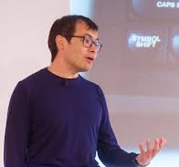
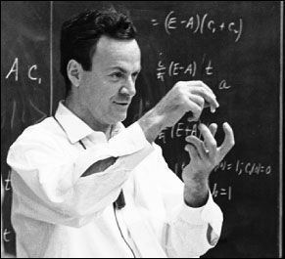
Why try to build a mind?
The ultimate test of understanding something is being able to recreate it -- Demis Hassabis
What I cannot build I do not truly understand
-- Richard Feinman

Slide 3
To what purpose?
To build better artificial systems to complement or support human intelligence and enhance products and services
This is the goal at Google, Amazon, and Facebook
To provide new insights into how our own minds work
This is the goal we focus on in this class
We will learn about work done for other goals to help us in this effort
We will also think about the aspects of human cognition these models can help us understand

Slide 4
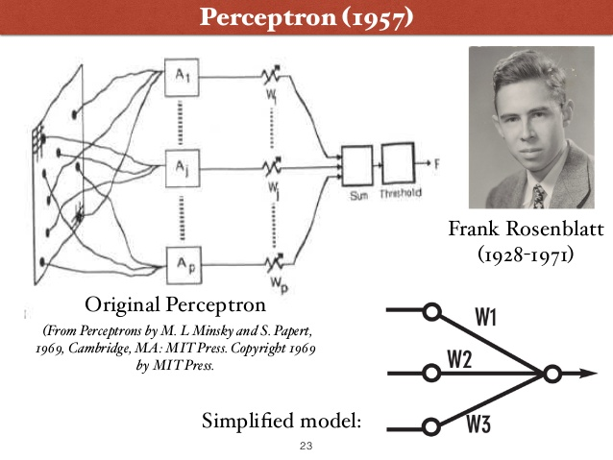
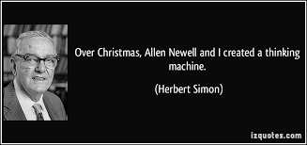
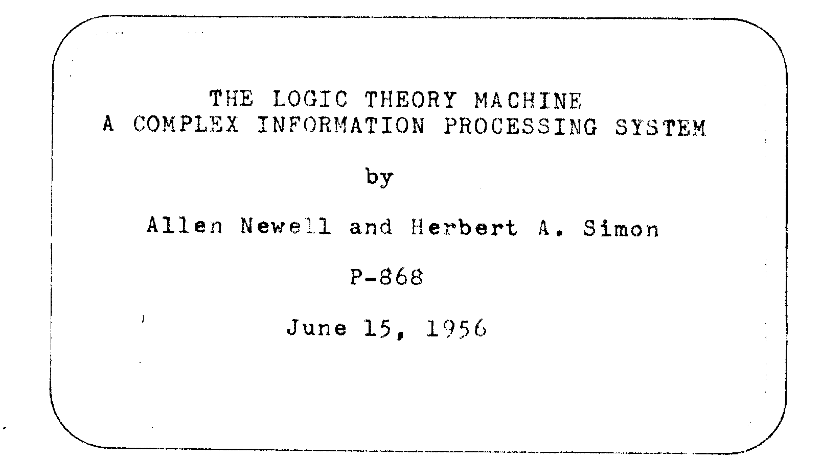
What Kind of an Artificial Mind?
Notes:
The point of this slide is to emphasize that for at least the last 65 years or so, approaches to understanding intelligence have been inspired both by the nature of the human brain and by capabilities of computers -- these tools have inspired contrasting approaches. You can hint that the approaches are beginning to merge, though you may want to save that point to bring up near the end

Slide 5
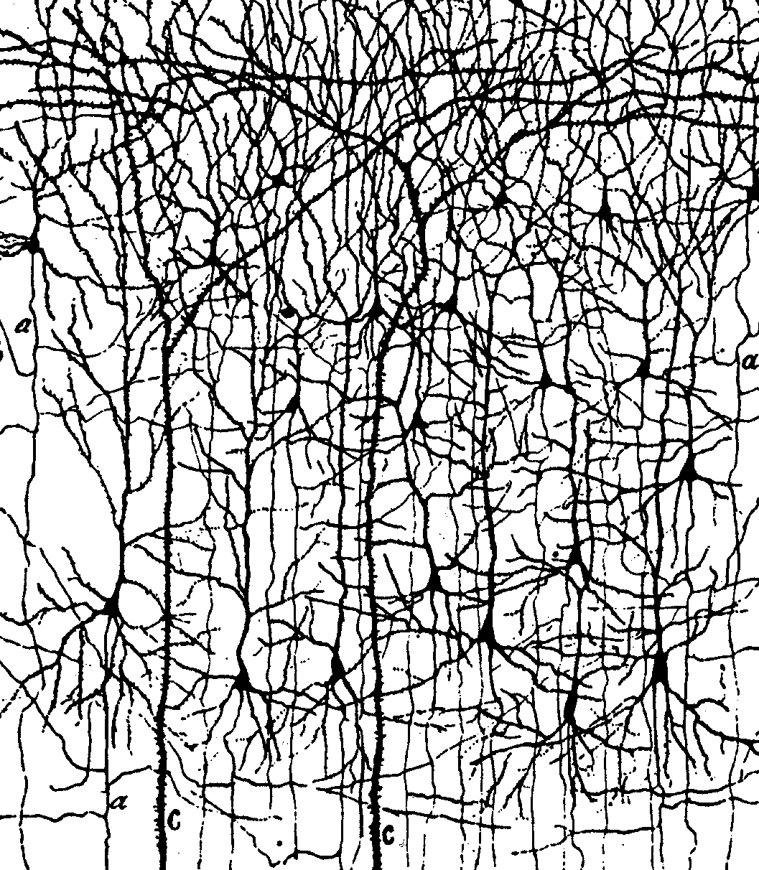
Motivations from the brain
The brain looks like a neural network
Notes:
Slide shows just a tiny subset of the neurons – and fails to show all the synapses onto them

Slide 6
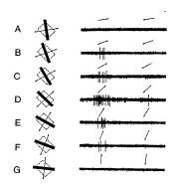
Motivations from the brain
The brain looks like a neural network
Neurons respond to interesting features in the environment in a graded and continuous way

Slide 7
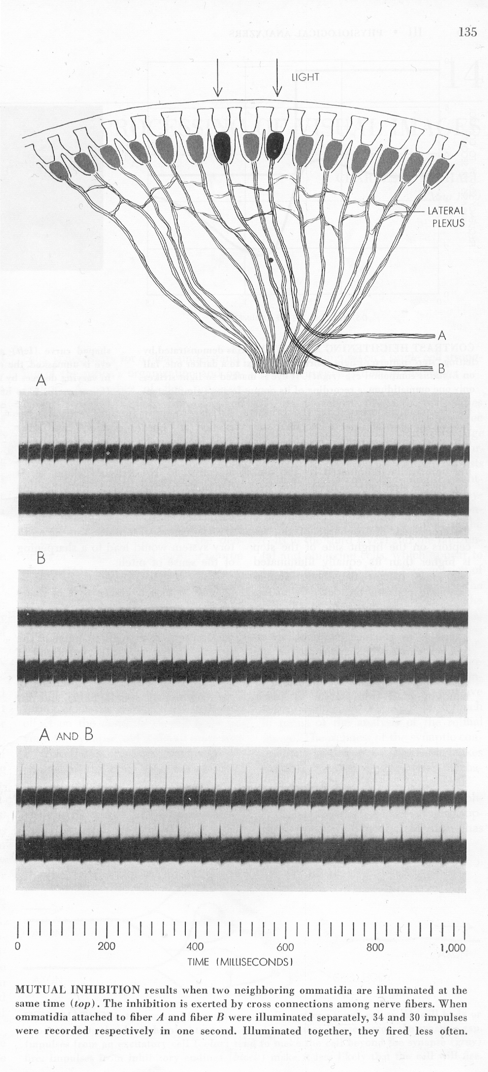
Motivations from the brain
The brain looks like a neural network
Neurons respond to interesting features in the environment in a graded and continuous way
Excitation and inhibition shape neural responses
Notes:
I like this classic figure because you can see the inhibitory connections, in the lateral nexus – Light shined on just one of the ‘omatidea’ results in strong excitation. If you shine a light on both at the same time, neither fires as strongly due to inhibition through the lateral nexus. Grey looks

Slide 8
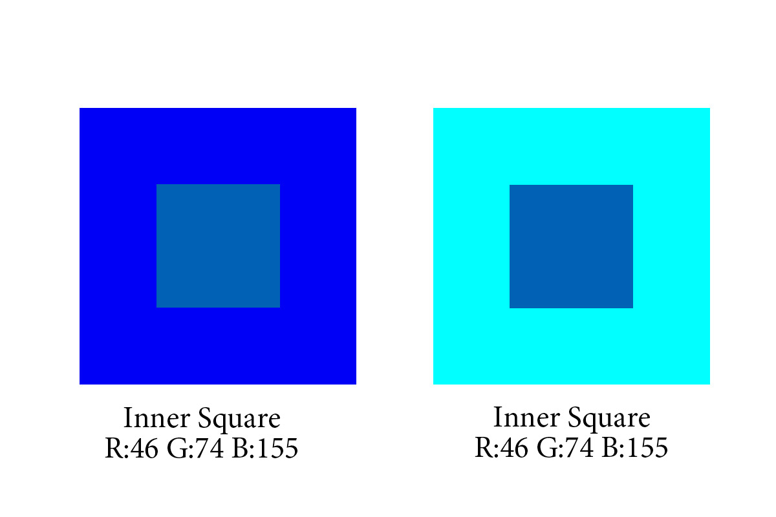
Motivations from the brain
The brain looks like a neural network
Neurons respond to interesting features in the environment in a graded and continuous way
Excitation and inhibition shape neural responses
Such influences can explain contrast effects in human perception
Notes:
I like this classic figure because you can see the inhibitory connections, in the lateral nexus – Light shined on just one of the ‘omatidea’ results in strong excitation. If you shine a light on both at the same time, neither fires as strongly due to inhibition through the lateral nexus. Grey looks

Slide 9
Motivations from the effort to understand human abilities
Contextual effects in perception
Multiple graded constraint satisfaction in many domains
Notes:
All aspects of an input influence how see and interpret all other aspects – note went and event in the sentences

Slide 10
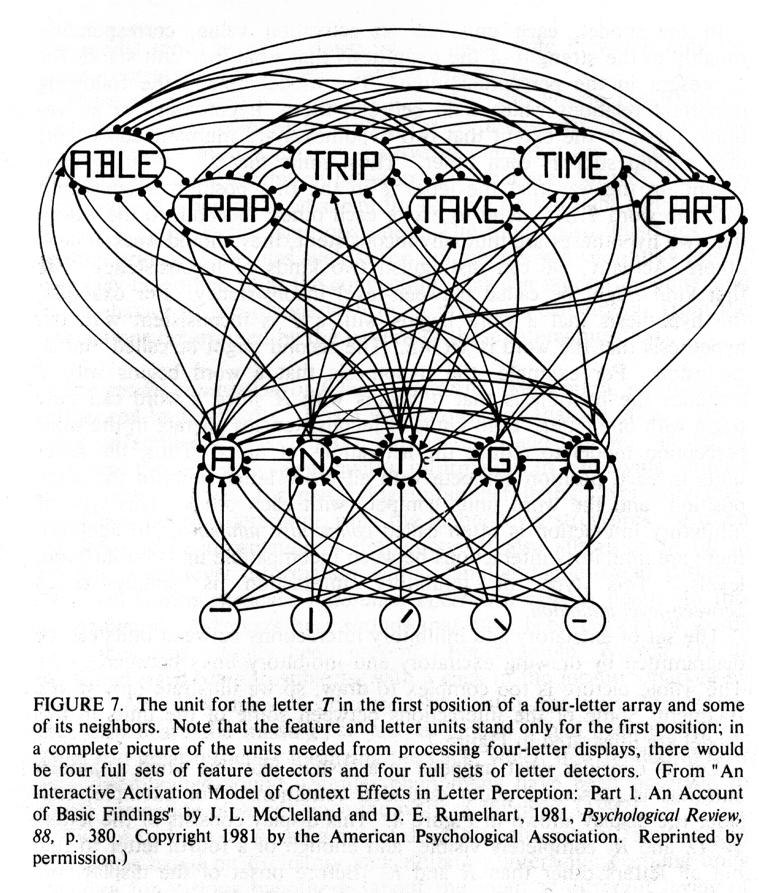
Neural network models as constraint-satisfaction systems
The interactive activation model
Perception emerges from excitatory and interactions among simple neuron-like processing units.
Captured context effects in perception that had been observed in human experiments.

Slide 11
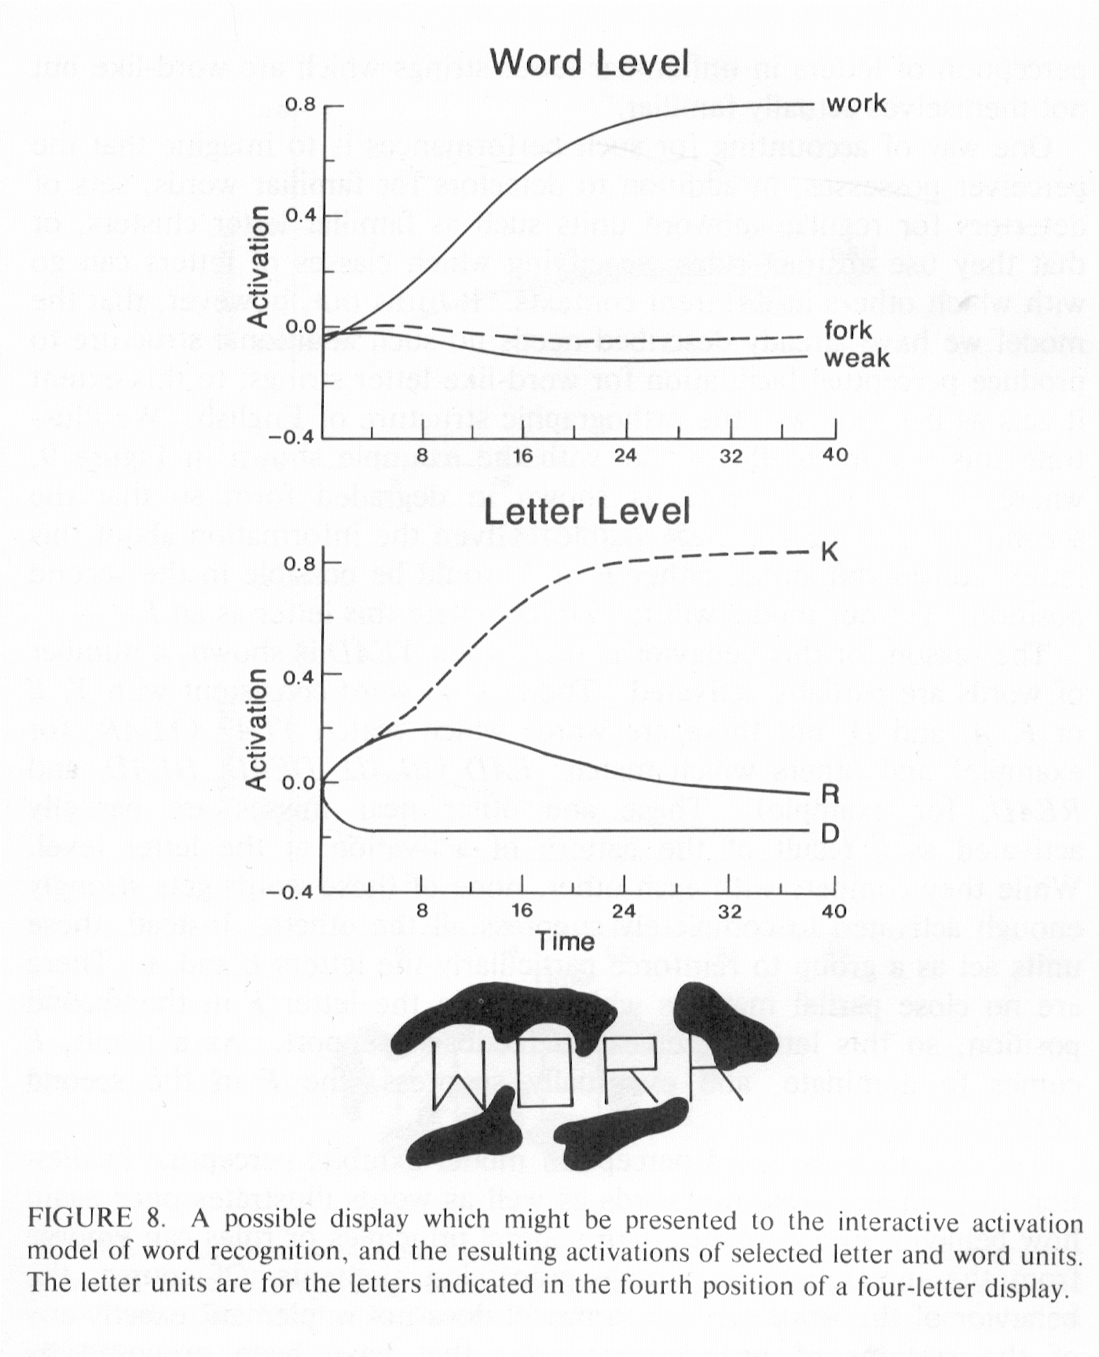
Neural network models as constraint-satisfaction systems
The interactive activation model
Perception emerges from excitatory and interactions among simple neuron-like processing units.
Captured context effects in perception that had been observed in human experiments.

Slide 12
Neural network models as constraint-satisfaction systems
The interactive activation model
Perception emerges from excitatory and interactions among simple neuron-like processing units.
Captured context effects in perception that had been observed in human experiments.
The same principles captured related effects in speech and other domains

Slide 13
Can neural networks help us understand how we learn?
Most of the applications of neural networks apply to things we learn to do
Can these models help us understand the nature and time course of human learning?

Slide 14
The perceptron
Sums weights from active inputs
Sum = W1 +W3
If Sum exceeds Threshold:
output = 1
Else
output = 0
If output = 0 and target = 1 increase W’s from active inputs
If output = 1 and target = 0 decrease W’s from active inputs
output:
1
0
Threshold
Sum

Slide 15
Strengths and weaknesses of Perceptrons
Inspired by the brain and statistics
Designed to learn from experience
Used an error-correcting learning rule
Learning was limited to one layer of connections, limiting the functions that could be learned
An explicit teaching signal was required
Units were binary, impeding propagation of learning signals
Initial progress was slow because computers were slow and expensive
Notes:
If you want to you can note that the binary nature of the units was one limitation that had to be overcome before we could figure out now to teach multi-layer neural networks

Slide 16
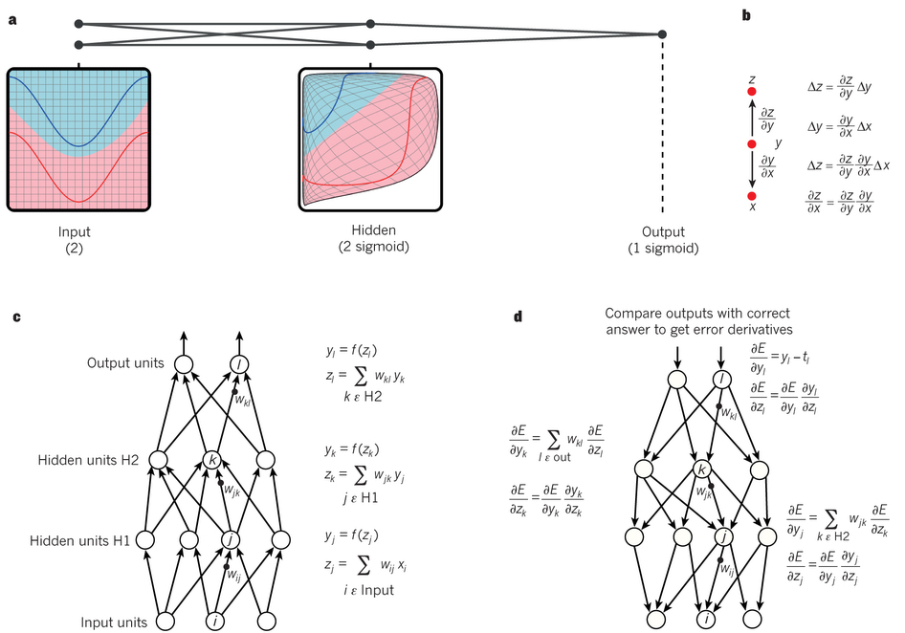
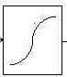
The second wave: Overcoming the limitations of the Perceptron
Continuous but non-linear units
Multiple layers to compute any computable function

Slide 17
The second wave: Overcoming the limitations of the Perceptron
Continuous but non-linear units
Multiple layers to compute any computable function
Continuity allows computing derivatives
Computers are 1,000 times faster and cheaper

Slide 18
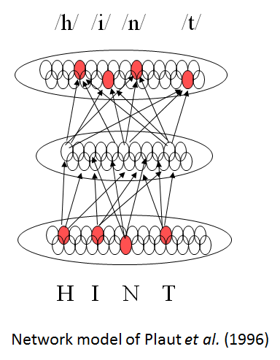
Early models of language and reading
When we learn language or when we learn to read, we gradually acquire implicit encoding and responding abilities that can be described by rules
… guided by an environment that encourages these tendencies
Fairly early models with just one hidden layer were able to capture many of these characteristics

Slide 19
What aspects of intelligence could a neural network actually capture?
Basic skills such as
Perception
Skilled action
Basic aspects of language and reading
Numerical intuition
But what about
Comprehension of sentences with complex structure and negation
Hard games like chess and Go
Or even
Inferring causality
Social cognition
Mathematical and scientific reasoning
Explanation and justification
…
Notes:
Point here is most people are ok with the idea that there are basic aspects of cognition that neural networks can help us understand, but we now begin to see more clearly how they may help us with other aspects

Slide 20
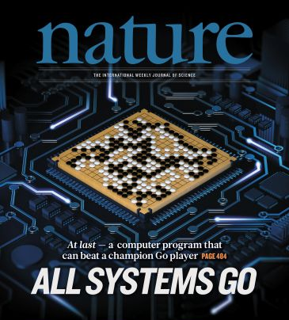
The third wave: The emergence of deep learning
Breakthroughs in machine speech perception and object classification
Exciting new applications in machine translation
Human-level action game performance and world-class performance in Go.

Slide 21
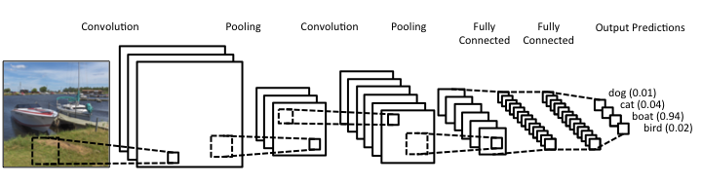
One variety of neural network: CNN
These models are not only effective for machine vision, but as we will see they provide detailed accounts of the response properties of neurons in the visual cortex

Slide 22
Other varieties of deep neural networks
Aut0-encoder networks
Support unsupervised learning, providing a good start for supervised learning
Recurrent neural networks
Allow computations to unfold overtime
Networks trained with reinforcement learning
Can discover new ways to solve a problem
Can reward themselves, and so be autonomous learners

Slide 23
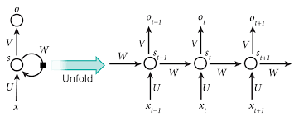
Other varieties of deep neural networks
Aut0-encoder networks
Support unsupervised learning, providing a good start for supervised learning
Recurrent neural networks
Allow computations to unfold overtime
Networks trained with reinforcement learning
Can discover new ways to solve a problem
Can reward themselves, and so be autonomous learners

Slide 24
Understanding and producing complex language?
Notes:
As a follow up to the recurrent network slide, this shows how combining FF and recurrent networks can begin to address a complex scene interpretation task
You could also discuss Google Translate if you like

Slide 25
Other varieties of deep neural networks
Aut0-encoder networks
Support unsupervised learning, providing a good start for supervised learning
Recurrent neural networks
Allow computations to unfold over time
Networks trained with reinforcement learning
Can discover new ways to solve a problem
Rewards can be internal (e.g. novelty, mastery) allowing autonomous learning

Slide 26
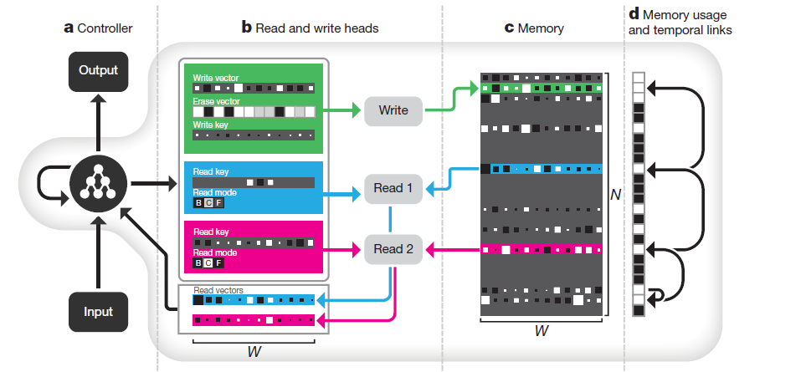
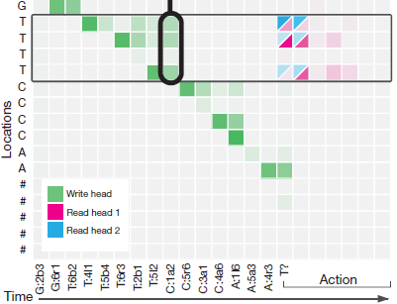
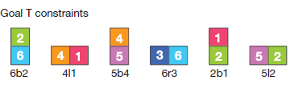
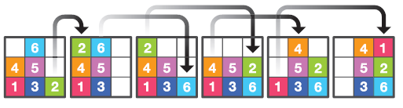
A new departure: The neural ‘Turing Machine’ and the Differentiable Neural Computer (Graves, Wayne et al, 2016)

Slide 27
Your responses to the reading
Emergent vs Explicit representation of structure
Biological vs Computer-based computation
Need for massive balanced data for learning
Learning and development
Memory and connections
Scalability
Simplicity, flexibility, and analytic understanding

Slide 28
An exciting opportunity
Most of the developments in the third wave of neural network research are not intended as models of human abilities
It could be argued that in many ways some of them exploit super-human resources, such as more computer power are larger trainings sets than humans have access to
But they provide us with a tremendous opportunity
New tools that we can use to model human abilities
New tasks that can finally be tackled using neural network models
These models are also still quite limited in some ways.
As students in this course, you have the opportunity to pioneer the application of these new developments to understanding human intelligence, and even to contribute to overcoming some of these existing models’ limitations

Slide 29
Psychology 209 – Goals and Approach
To familiarize students with:
the principles that govern learning and processing in neural networks
the implications and applications of neural networks for human cognition and its neural basis.
Provide students with an entry point for exploring neural network models, including
software tools and programming practices
approaches to testing and analyzing deep neural networks for cognitive and neural modeling.

Slide 30
Readings, homeworks, final projects
Up to 20 pages of reading
Completing the reading before class is expected
Preparation statements required before class for most sessions
Two main homeworks and a short starter homework
Main homeworks require demonstrating conceptual understanding, learning and manipulation of simulation tools in Python & Torch
Project
Proposal due end of week 7
Brief presentations during week 10
10-page paper due Wed of Finals week

Slide 31
Reading for next time
The reading for next time is the first 14 pages of a longer paper – the second half is assigned for the following session
The paper covers a set of basic neural network concepts and conventions that we will be using throughout the course, and also links neural networks to optimal Bayesian inference
The first homework will closely assess your understanding of the concepts in the first half of the paper, and the ideas in the second half build on the ones in the first half, so it is important to understand them
So read the paper carefully, and try to do the exercises suggested at various points. Start in on the short homework due Friday

